Slide 1
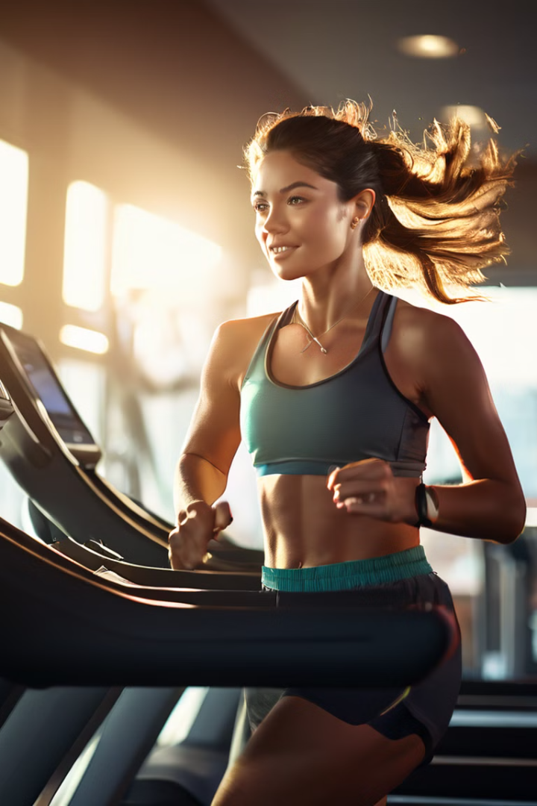

Calories Burnt Prediction Project
This project aims to predict the number of calories burnt during exercise using machine learning techniques. The project utilizes two datasets containing user information and exercise details to train an XGBoostRegressor model. The model's performance is evaluated using the absolute mean error, and a predictive system is developed to estimate calorie expenditure.
by Sankari C

Slide 2
Project Datasets and Objectives
Datasets
Objectives
The project uses two datasets: one containing calorie information and another with user details such as User_ID, Gender, Age, Height, Weight, Duration, Heart_Rate, and Body_Temp.
The primary objective is to predict the number of calories burnt during exercise. The project also analyzes the relationship between exercise and body temperature, as well as the correlation between heart rate and exercise duration.

Slide 3






Project Workflow Overview
Data Sets
Collection of exercise and user data.
Data Preprocessing
Cleaning and preparing the data for analysis.
Data Analysis
Exploring and understanding the data patterns.
Train Test Split
Dividing the data for model training and testing.
XGBoostRegressor
Training the model to predict calorie expenditure.
Evaluation
Assessing the model's performance.

Slide 4

Data Collection and Preprocessing
1
Loading Datasets
The exercise and calorie datasets are loaded into the project.
2
Combining Datasets
The two datasets are combined using the concatenation method.
3
Shape and Information
The shape of the combined dataset is checked, and basic information is obtained.
4
Missing Values
The dataset is checked for any missing values.

Slide 5

Data Analysis: Statistical Measures
Age
Height
The age of people who exercise ranges from 20 to 79 years.
The height of people who exercise ranges from 123 to 222 cm.
Weight
The weight of people who exercise ranges from 36 to 132 kg.

Slide 6
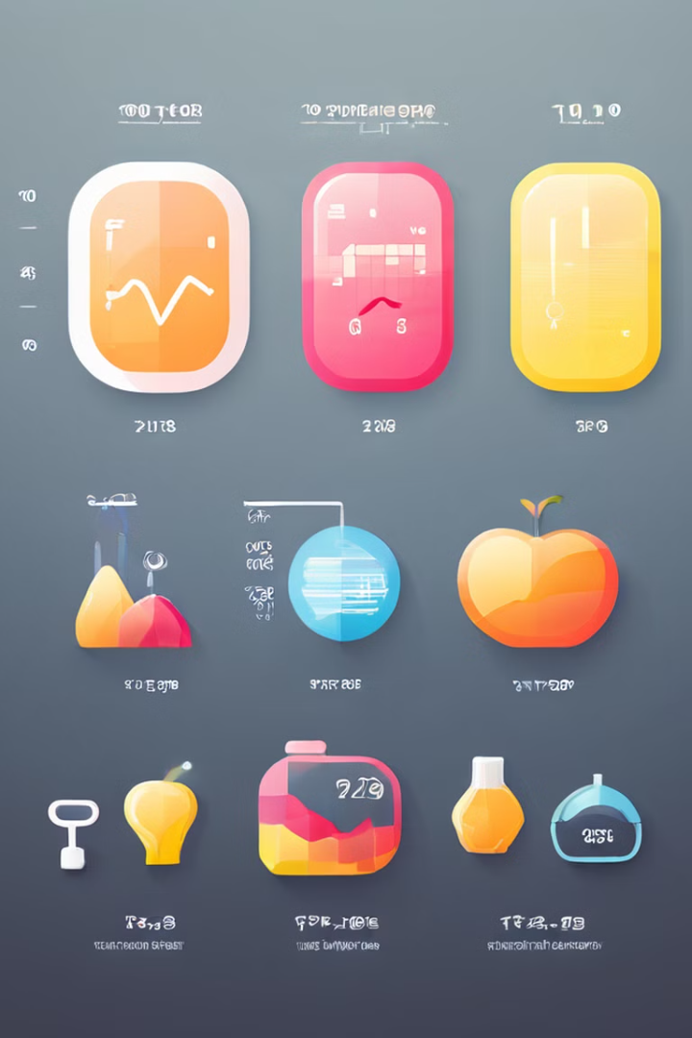



Data Analysis: Exercise Metrics
Duration
Heart Rate
Body Temperature
Exercise duration ranges from 1 to 30 minutes.
Heart rate during exercise ranges from 67 to 128 bpm.
Body temperature during exercise ranges from 37 to 41 degrees Celsius.

Slide 7
Visualization of the Analysis
Gender Distribution
Age Distribution
Analyzing the distribution of the gender column to compare data points for males and females.
Analyzing the distribution of the age column to understand the age range of the participants.

Slide 8

Model Training and Evaluation
The data is split into feature data and targeted data, and then further split into training and testing sets. The XGBoostRegressor model is trained on the training data. The model's performance is evaluated on the test data, and the absolute mean error is calculated.
The absolute mean error is found to be 1.4833678883314132, which is a very good value, indicating that the model's predictions are very close to the actual values.

Slide 9
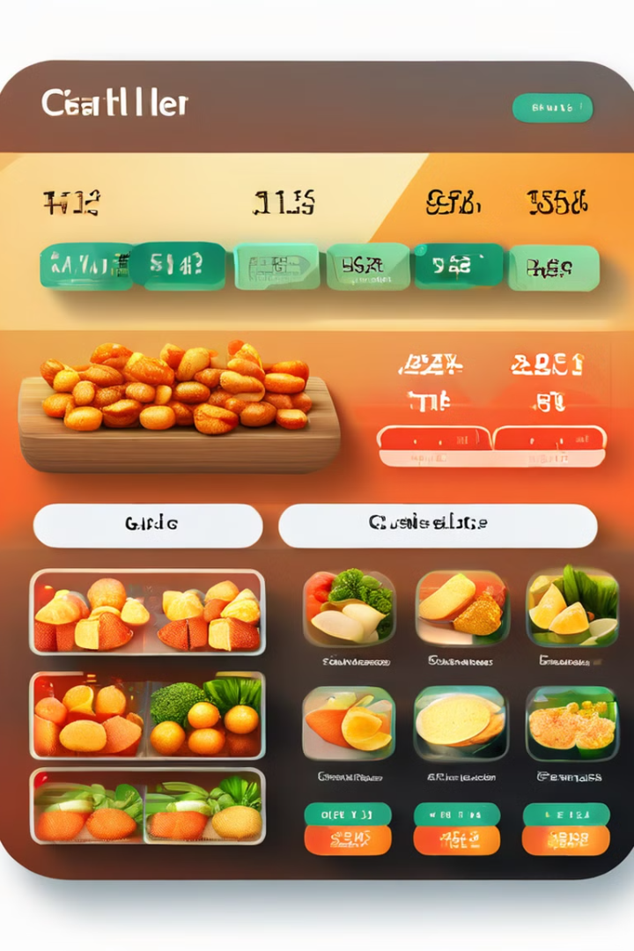
Predictive System for Calorie Expenditure
A predictive system is developed to predict the number of calories burnt during exercise. This system can be used to estimate calorie expenditure based on user inputs such as age, gender, height, weight, exercise duration, heart rate, and body temperature.

